Slide 1


IOTA SWEETHEARTS’ AUXILIARY
Iota Phi Theta Fraternity®, Inc.
Iota Sweethearts’
Re-Boot
Approved By:
The Grand Council
1/2012

Slide 2
Table of Contents
Meeting Purpose
In Remembrance
Iota Sweethearts Today, Tomorrow and Beyond
National Sweetheart Committee
Grand Council Decision
Sweetheart Mission/Purpose
Sweetheart Myths
Potential Sweetheart Courts
Sweetheart History
Sweetheart Paraphernalia Guidelines
Questions and Wrap-Up

Slide 3

Meeting Purpose
The Sweetheart Boot Camp is geared towards Iota Sweethearts and Iota Brothers to attend (for all who interface with Iota Sweethearts and Potential Sweethearts). It is designed to be educational, welcoming and interactive. This can be revised by Grand Council as the need arises. These guidelines are to begin early 2012.
Utilizing key points from this session, the goals are the following:
Goal 1:
To have a better understanding of the relationship between Iota Brothers and Iota Sweethearts, and to align the protocols for Sweethearts and potential Sweethearts across regions. This will assist with building relationships within the Iota Family and beyond, and make those relationships more effective.
Goal 2:
To recap the history of Iota Sweethearts, communicate the current unified mission and discuss any myths.

Slide 4
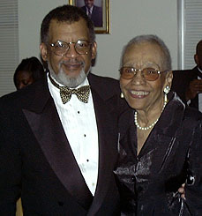

In Remembrance
Eternal Sweetheart – Audrey S. Brooks
(as designated by Alpha Chapter Brothers in 1966)
Ms. Audrey S Brooks
(05/23/1921 – 12/27/2003)
with her son, Iota Brother Wesley “Butch” Jennings (4 Alpha 64)

Slide 5
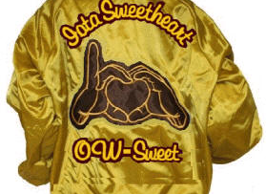
Today – Tomorrow & Beyond
Iota Phi Theta Fraternity®, Inc.

Slide 6
Sweethearts have worked to:
Establish a BY-LAWS prototype (Directives)
Set a foundation for organization – I.e., Sweetheart Regional Executive Boards (E-Boards)
Continue being entrenched in IOTA’s culture
Continue showing that they want to maintain being a part of IOTA PHI THETA FRATERNITY®, INC. through providing organized support and fellowship
Iota Phi Theta Fraternity®, Inc.

Slide 7
Fraternity Challenges
Interaction with Iota Sweethearts’ Auxiliary
Multiple versions of Sweetheart By-Laws / Directives across regions
Inconsistent communication between Sweethearts and Brothers and Sweethearts to Sweethearts and Brothers to Brothers
Inconsistent protocols leading to risks for Iota Phi Theta Fraternity®, Inc.
Iota Phi Theta Fraternity®, Inc.

Slide 8
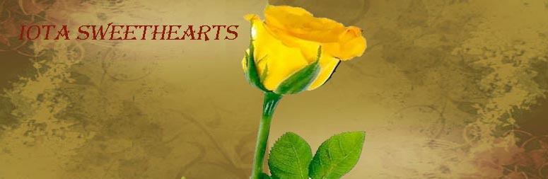
National Sweetheart Committee
Purpose: To develop a national operational guide to address a proper working relationship between Brothers of Iota Phi Theta Fraternity®, Inc. and the Iota Sweethearts’ Auxiliary. Implement a new protocol for all regions / chapters within the fraternity.
Iota Phi Theta Fraternity®, Inc.

Slide 9
Grand Council Decision
A Sweetheart operational guide (Directive) will be rolled out nationally so each region will have consistency.
Each region with active Iota Sweethearts and those which engage in Potential Iota Sweetheart activity should establish an Iota Sweetheart Regional Executive Board.
Iota Sweethearts and associated activity shall be governed by the Regional Sweetheart Executive Boards, which will function as a central point of authority for Iota Sweethearts.
Sweetheart Executive Boards will be overseen regionally by the respective Fraternity Regional Executive Board.
All Executive Boards would be sanctioned by the Grand Council.
Iota Phi Theta Fraternity®, Inc.

Slide 10
Iota Sweetheart Auxiliary
Purpose
09/28/2011/National Sweetheart Committee
“The purpose of the Iota Sweethearts’ Auxiliary is to maintain the spirit of being a support system for the Brotherhood of Iota Phi Fraternity®, Inc., and taking an active role within our communities to promote education, health, and social awareness.”

Slide 11
Sweetheart Myths

Slide 12
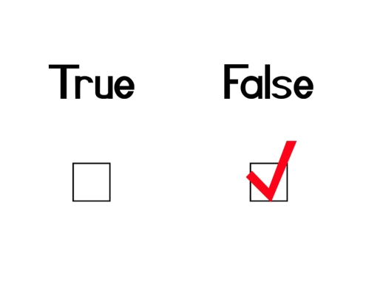
Sweetheart Myths
Iota Sweethearts were founded in 1964
  False: Iota Sweethearts have not been formally founded or incorporated nationally as an auxiliary as its own entity.
Ms. Brooks was named the Eternal Sweetheart in 1964
  False: Ms. Brooks was named the Eternal Sweetheart in 1966.
Iota Sweethearts are a sorority
  False: Iota Sweethearts are not a sorority
Iota Sweethearts cannot join a sorority
  False: Being a Sweetheart does not preclude you from joining a sorority. There is not a conflict of interest in joining a sorority. Many Iota sweethearts have gone on to join sororities and still acknowledge themselves as an Iota Sweetheart.
A member of a sorority cannot become an Iota Sweetheart
  False: Assuming the candidate meets all necessary criteria, being in a sorority does not preclude a lady from becoming an Iota Sweetheart.
Iota Sweethearts ‘pledge’
  False: Iota Sweethearts do not ‘pledge.’

Slide 13
Sweetheart Myths
To become or stay an Iota Sweetheart, there must be a physical relationship with an Iota Brother
  False: Physical contact with an Iota Brother is not a requirement. In addition, activity should not conflict with one’s moral or religious principles.
After college or a certain age, there is no purpose to being an Iota Sweetheart
  False: The purpose of being an Iota Sweetheart still stands to assist the Brothers of Iota. There are still local and national activities with which to participate and the networking and bonds continue. While the structure varies in different regions, there’s always work to be done, and it is what you make of it.
Iota Sweethearts are members of the Fraternity
  False: Iota Phi Theta® is a fraternity of men. Iota Sweethearts are not members of the fraternity.
Iota Brothers do not respect Iota Sweethearts
  False: As a whole, Iota Sweethearts are a respected part of the Iota family. Some may have experienced a feeling or actual occurrence of disrespect, from specific individuals, but this should not be used to characterize the Brothers of Iota as a whole.

Slide 14
Sweetheart Myths
Iota Sweethearts are groupies
  False: Iota Sweethearts are an acknowledged, respected and honored tradition of the Fraternity. Sweethearts are a strong support force and while having fun with a sisterly spirit, Sweethearts work hard with community service, fundraisers, event planning assistance, and other support, as needed.
Iota Sweethearts cannot date or marry Iota Brothers
  False: Individual personal relationships are their personal decision. It is not an organizational requirement, there are several very successful couples within the Iota family.
Alumni/Graduate Sweethearts do not want to work with Undergraduate Sweethearts and Undergraduate Sweethearts don’t want to work with Alumni/Graduate Sweethearts
  False: There are several Alumni/Graduate and Undergraduate Sweethearts that work very cohesively together as Sweethearts and many have established bonds of friendship. At times, there are generational gaps that need to be embraced, and understood which may get mischaracterized as a lack of willingness to work together.

Slide 15
Sweetheart Myths
Iota Sweethearts are Constitutionally bound entity of the Fraternity
  False: Iota Sweethearts are not bound by Fraternity constitution or Bylaws
Sweethearts can use – ARABTTDID (Always Remembering Audrey Brooks ‘Til The Day I DIE)
  False: This is a derivative of Iota Phi Theta’s treasured acronym L.I.P.T.T.D.I.D. Out of respect for the fraternity, this should not be used. In addition, the use of A.R.A.B. may be offensive to the Arab culture; therefore, please refrain from acronyms or phrases that may cause organizational or cultural conflicts.
Iota Sweethearts have line numbers
  False: Iota Sweethearts do not pledge; therefore, Potential Sweethearts have a Potential Court, not a line. Numbers are a pledge term; therefore, Potential Sweethearts should not have numbers. Sweethearts should not have numbers on their paraphernalia.
Iota Sweethearts have Sands, Ships, etc.
  False: Sands, Ships, etc. are terms associated with pledging. Iota Sweethearts do not pledge; therefore, these terms should not be used in reference to Sweethearts.

Slide 16
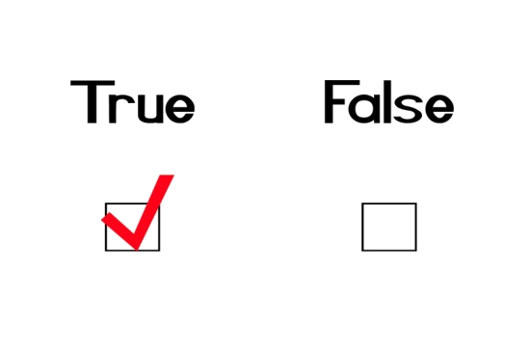
Sweetheart Myths
Q&A and Discussion

Slide 17
Potential Sweetheart Courts

Slide 18
Potential Courts
Cannot exist without a Brotherhood Intake line at their respective chapter/school
Cannot become Sweethearts without a corresponding intake line having crossed at their respective chapter/school
The number of potential Sweethearts cannot exceed the number of intakes on the brotherhood Intake line (ex: 5 intake – 5 potentials)
Do NOT PLEDGE or INTAKE – They are not on line.
Will learn information about Iota / Sweethearts

Slide 19
Information for Potential Sweethearts
A. Official Colors of Iota Phi Theta Fraternity®, Inc.
B. Fraternity founding date and location
C. Surviving Founders
D. Eternal Sweetheart, Eternal Queen and First Queen
E. Sweetheart Symbol and Flower
F. Sweetheart Motto
G. Name and Colors of other NPHC organizations
H. The importance of keeping Iota Phi Theta Fraternity®, Inc. information sacred
I. International Grand Polaris and International Vice Grand Polaris
J. International Director of Sweetheart Auxiliary Affairs – if applicable.
K. Their respective Regional Polaris and Assistant Regional Polaris
L. Their respective Chapter Polaris and Vice-Polaris
L. Their respective Regional Sweetheart E-Board - President and Vice-President
M. Chapters within their respective Region
N. Current names of Iota Regions
Iota Phi Theta Fraternity®, Inc.

Slide 20
IOTA Sweethearts Involvement
During Potential Court
Will select a “Court Advisor” – No court mothers, dean, etc.
Court Advisor will work with Chapter brotherhood liaison or coordinator (Dean .. Assistance Dean) of the intake line
Will assist Potentials in obtaining information about Iota / Sweethearts
Note: Potential’s will now learn the Sweetheart song once they become a Iota Sweetheart.
Iota Phi Theta Fraternity®, Inc.

Slide 21
Potential Sweetheart Courts
Q&A and Discussion

Slide 22
Sweetheart History
OW SWEET!

Slide 23
Sweetheart Song
Sweetheart Song
(Originally sang by Iota Brothers to a Sweetheart Court. More recently used by Sweethearts to share with each other for Sweetheart Courts, weddings, and other occasions).
Iota Sweetheart, fair as a flower
A precious gem to see
Oh lovely maiden, girl of the hour
You are the one for me
With a love so true, there is no one but you
Our hearts show what we mean
Iota Sweetheart know that I love you
Iota Phi Theta Queen

Slide 24

Sweetheart History
IOTA
Eternal Sweetheart: Audrey Brooks.
Eternal Queen: Yvonne Howard.
First Queen: Renee Alvaret.
Sweetheart Symbol: Teddy Bear.
Sweetheart Flower: Yellow Rose.
Sweetheart Motto: “It Takes a Special Lady!”

Slide 25
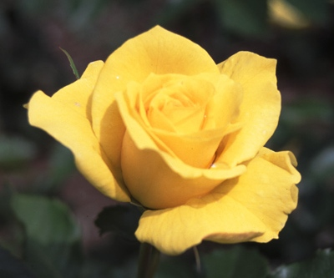
Sweetheart History
Q&A and Discussion
OW SWEET!

Slide 26
Sweetheart Guidelines

Slide 27
Sweetheart Acknowledgement
Sweetheart call: Ow-Sweet!
  I-Sweet has been used in the past – Obsolete
  Sweet-Ow! Has been used in the past – Obsolete
Ways to become an Iota Sweetheart:
  Undergraduate
  Graduate
  Honorary Iota Sweetheart (Deemed by Grand Council Only)
Historic:
  Sweetheart Coronation (inactive process)
  Iota Wife (inactive process) - Now only recognized as a wife of a Brother of the fraternity. However, if she follows the Potential Sweetheart Court Process then she can be acknowledged as an Iota Sweetheart. If this process is not followed, she will be acknowledged solely as an Iota Wife.

Slide 28
Sweetheart Paraphernalia (Pari) SHALL NOT contain:
1. NO FRATERNITY SYMBOLS. E.G. IPT OR CENTAUR LOGO
OR OTHER NON-OFFICIAL LOGO.
2. NO FRATERNITY SHIELD OR SHIELD OF ANY KIND.
3. NO FRATERNITY CALL: "OW-OW"
4. NO FRATERNITY NAME. E.G. "IOTA PHI THETA
SWEETHEART"
5. NO INDICATION OF PLEDGING. E.G. "PREZ" OR "FREAK."
6. NO INDICATION OF A RECOGNIZED ORGANIZATION (I.E.CLUB).
7. NO LINE NUMBERS, 'SHIPS', 'CROSSING DATES/TIMES', OR
OTHER TERMS OR SYMBOLS REPRESENTING PLEDGING.
MEMORANDUM: SWEETHEART PARAPHERNALIA IS MAINLY WORN TO
PROMOTE THE FRATERNITY. THE ONLY PERMISSIBLE COLORS TO BE
WORN ARE CHARCOAL BROWN AND GILDED GOLD. NO OTHER COLORS
SUCH AS WHITE, BLACK, BEIGE, YELLOW, ETC., ARE TO COEXIST WITH THE OFFICIAL
FRATERNITY COLORS. THE ONLY EXCEPTION IS A RED HEART.
Iota Phi Theta Fraternity®, Inc.

Slide 29

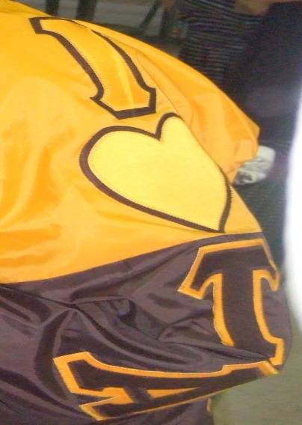



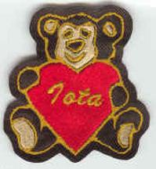
Examples: This is right
Iota Phi Theta Fraternity®, Inc.

Slide 30






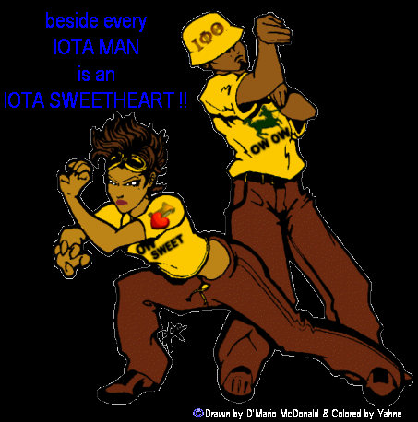
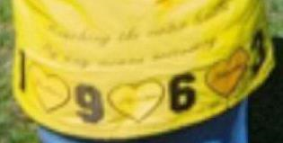
Examples: This is Wrong
ARABTTDID
Iota Phi Theta Fraternity®, Inc.

Slide 31

Final Questions and Wrap-Up

